Slide 1

Predicting and comparing house price in canada

Slide 2

Team members
Anoop Jayaprakash
Roshin Baby
Deepesh Dinesh Kumar
Manikantan Sreekumar

Slide 3
Problem statement
Develop a machine learning model for predicting house prices using various features.
Create a tool to assist stakeholders in the real estate industry with informed decision-making.
Challenges include feature engineering, model selection, hyperparameter tuning, and user interface development.
Aim to deliver a comprehensive solution enhancing decision-making processes in the housing market.

Slide 4
Relevance of the project
Empowering Decision-Making: By accurately predicting house prices, the project empowers stakeholders in the real estate industry to make informed decisions regarding property investments, pricing strategies, and market trends
Market Transparency: By providing accurate predictions of house prices, the project promotes transparency in the real estate market, helping buyers, sellers, and investors understand the value of properties and make well-informed choices.
Risk Management: Access to reliable predictions allows individuals and businesses to assess the risks associated with various real estate transactions more effectively, enabling them to mitigate potential losses and optimize their investment strategies.

Slide 5
Data collection and preparation
Data collection
Data preprocessing
Exploratory Data Analysis
Feature engineering

Slide 6
Data collection
Dataset is collected from Kaggle which contains detail of Canadian housing
Our dataset contain various features related to real estate properties including their location, size, price etc.
DATA PREPROCESSING
Identified the missing values
Columns such as 'Address', 'Latitude', and 'Longitude' are dropped as they are deemed unnecessary for predictions.
Identified data type of the features

Slide 7
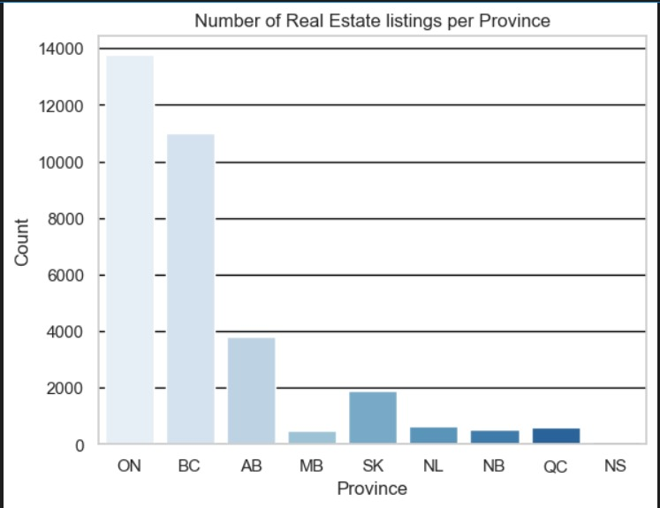
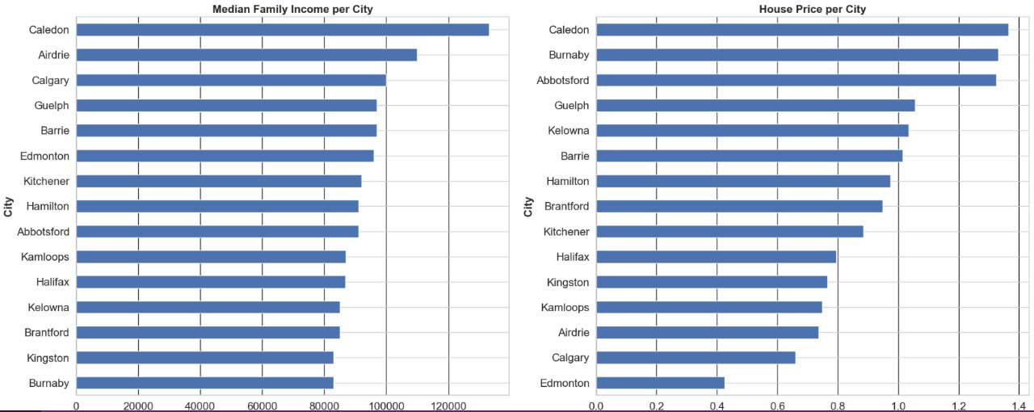
Exploratory data analysis
EDA on a real estate dataset, examining various aspects such as house prices, median family income, and the distribution of real estate listings across provinces and cities visually

Slide 8
Feature engineering
Replacing long province names with shorter name
One-hot encoding (OneHotEncoder) is applied to categorical features like 'City' and 'Province', dropping the first category to avoid multicollinearity
Ordinal encoding (OrdinalEncoder) is applied to categorical features like 'Number_Beds' and 'Number_Baths' to maintain the ordinal relationship between categories.
Standard scaling (StandardScaler) is applied to numerical features like 'Population' and 'Median_Family_Income' to standardize their values and bring them to a similar scale

Slide 9
Model overview
Linear regression :
Implemented linear regression with hyperparameter tuning using GridSearchCV.
The MSE for the best model was 5.12e11
The R-squared value for the best model was approximately 0.38, suggesting that around 38% of the variance in housing prices is explained by the independent variables.

Slide 10
Random forest
Implemented random forest with hyperparameter tuning using GridSearchCV.
The MSE for the best model was 4.71e11
The R-squared value for the best model was approximately 0.43, suggesting that around 43% of the variance in housing prices is explained by the independent variables.

Slide 11
Support vector machine
Implemented SVM with hyperparameter tuning using GridSearchCV.
The MSE for the best model was 7.81e11
The R-squared value for the best model was approximately 0.06,.

Slide 12
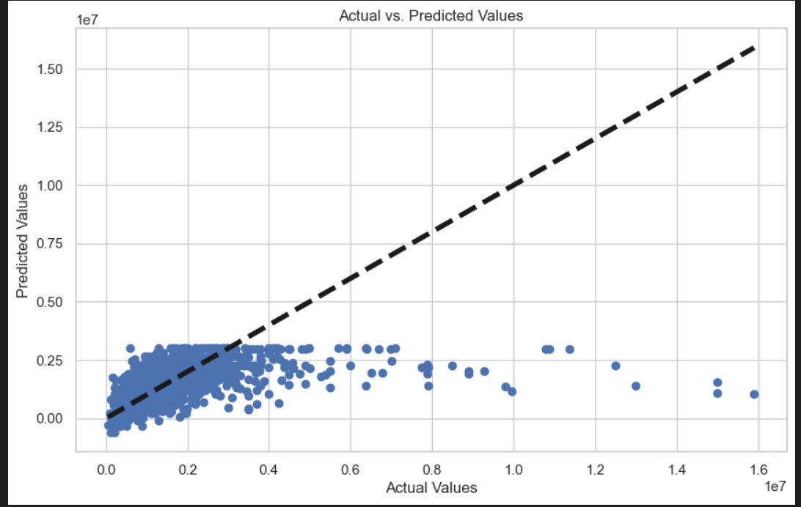

Model results for british colombia
Linear regression svm
R squared = 0.257 r squared= 0.25

Slide 13
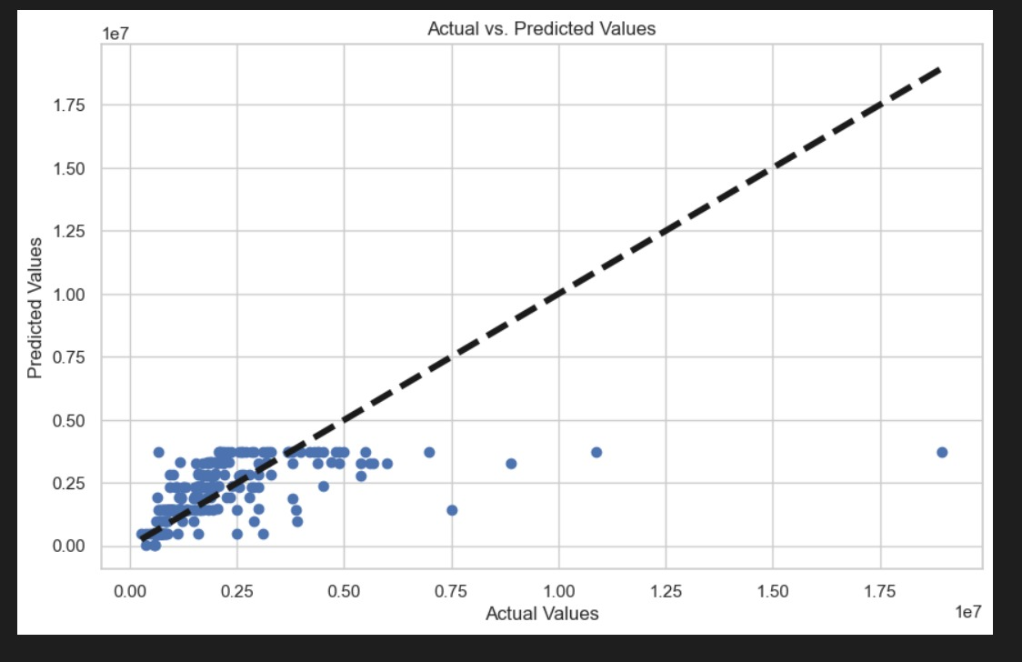
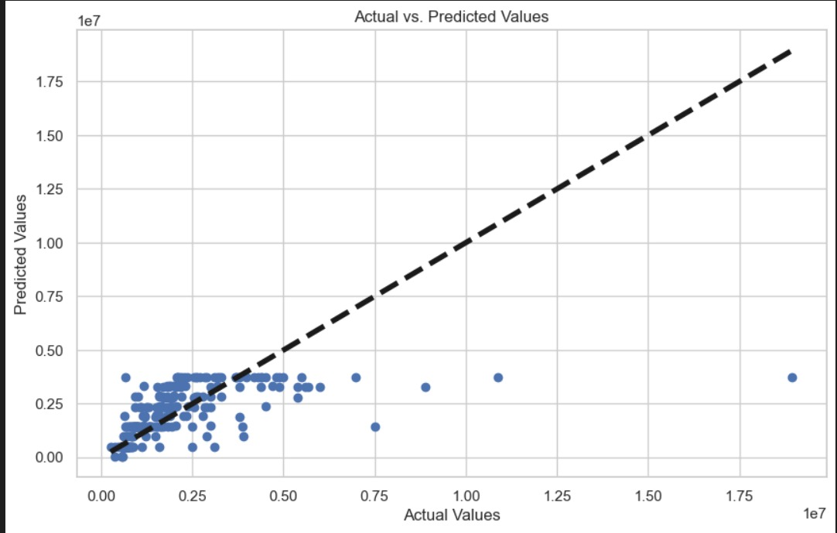
Model results for vancouver
Linear regression SVM
R squared = 0.343 r squared = -0.084

Slide 14
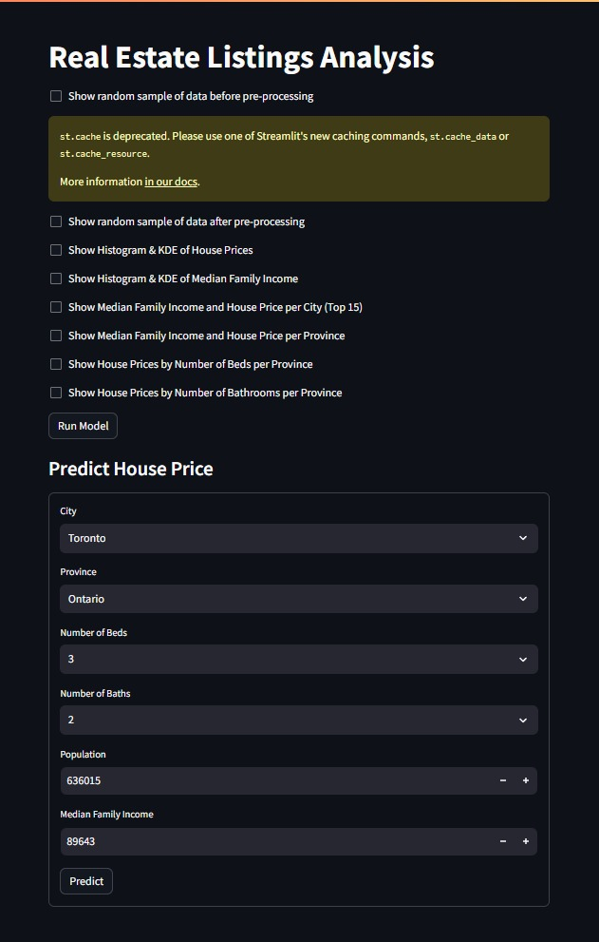
User interface
User interface is created by streamlit python library

Slide 15
conclusion
The Support vector machine emerged as the best-performing model for house price prediction.
Utilizing ensemble learning and hyperparameter tuning, SVM surpassed Linear Regression and Random forest.
A user-friendly Streamlit interface was developed, enabling easy access to the predictive tool for stakeholders.
This project highlights the efficacy of machine learning in delivering actionable insights for real estate investment decisions.

